Slide 1
Bestar Hospitality
https://www.bestarfurn.com/
TV Stand Series

Slide 2
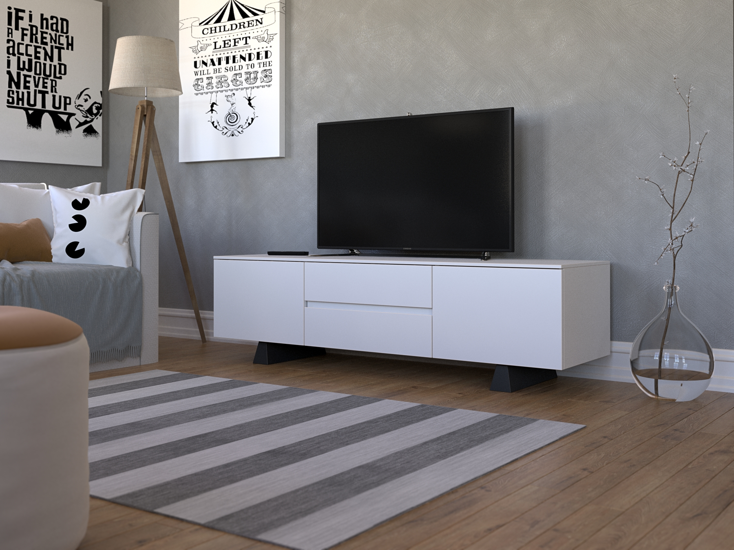
Tv-stand program
The bridge. 1600 mm white
Design Johan Hellström

Slide 3
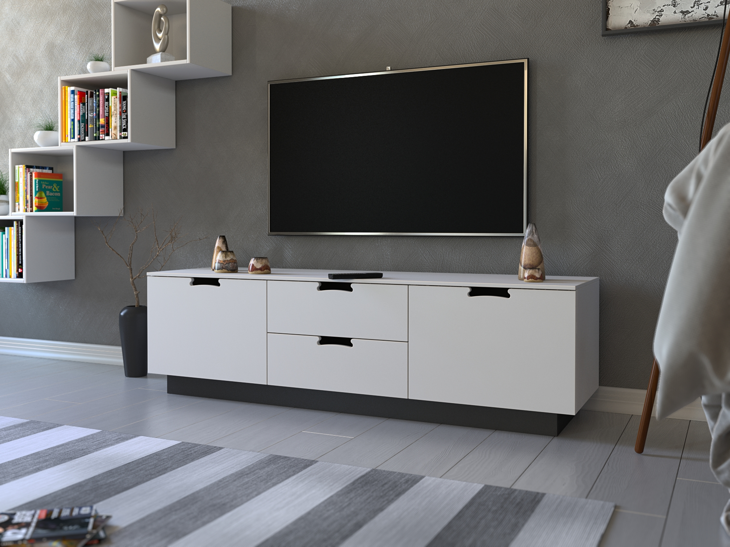
Tv-stand program
Country 1500 mm , white
Design Johan Hellström

Slide 4
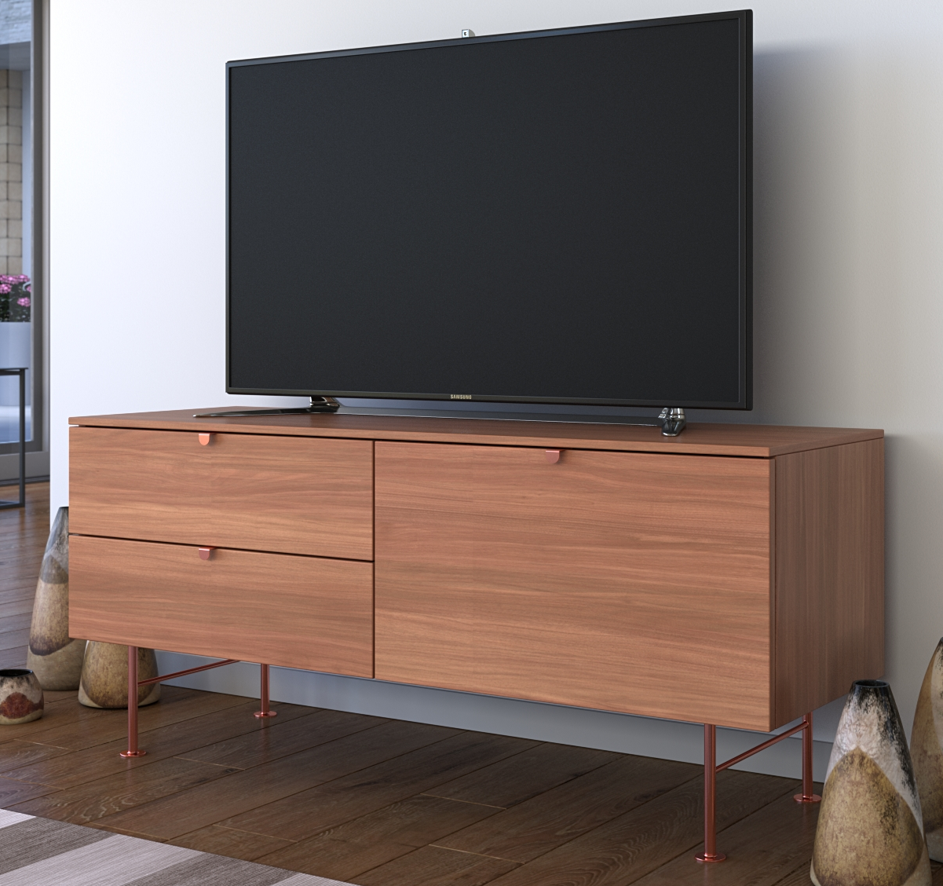
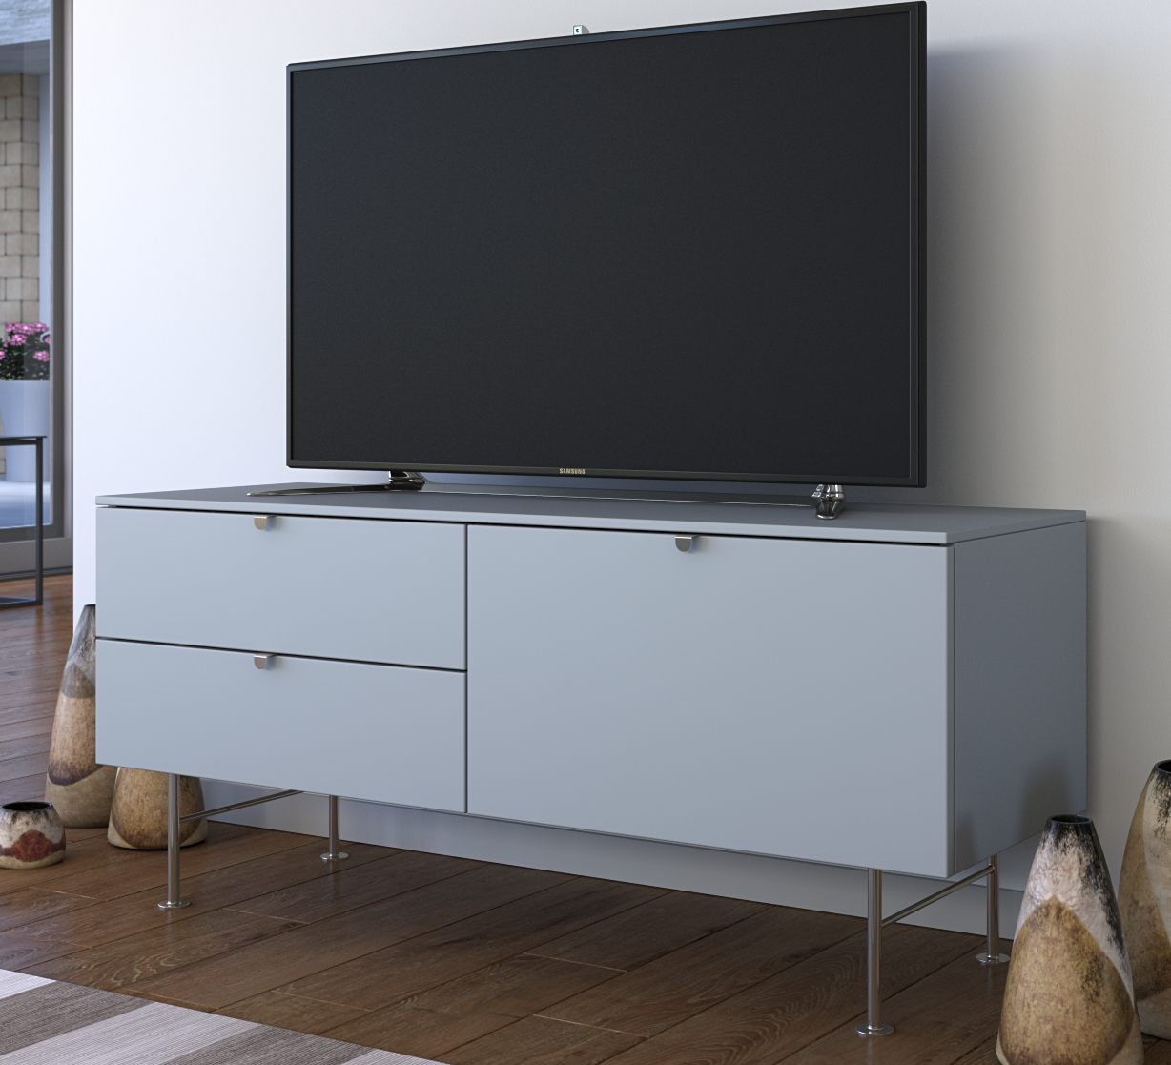
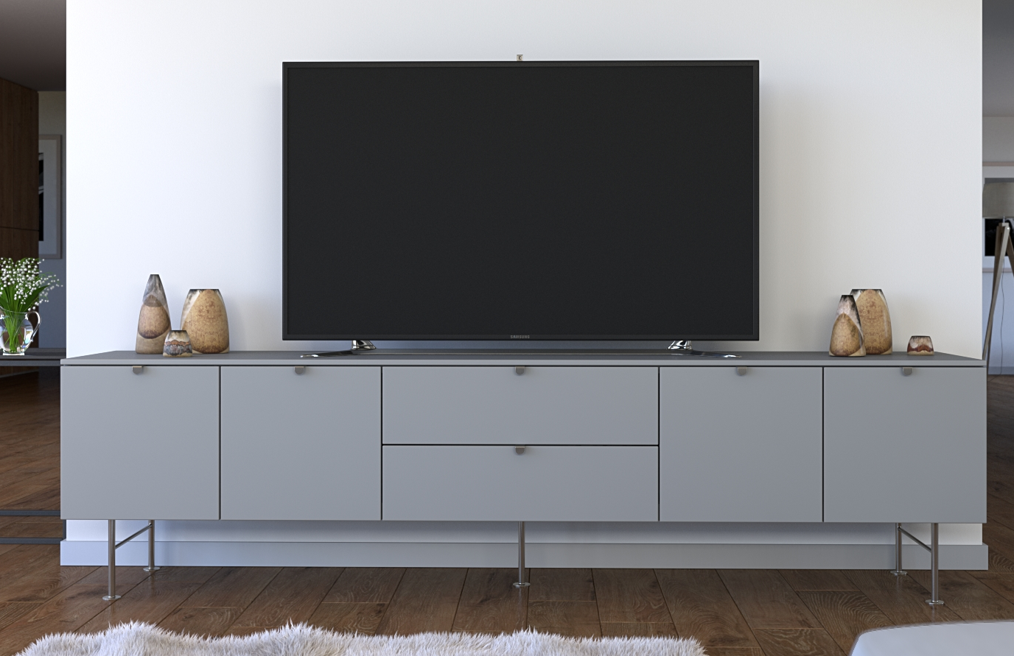
1200 mm
Tv-stand program
Wilson.
1200 mm
1600 mm
2000 mm
1600 mm
2000 mm
Design Johan Hellström

Slide 5
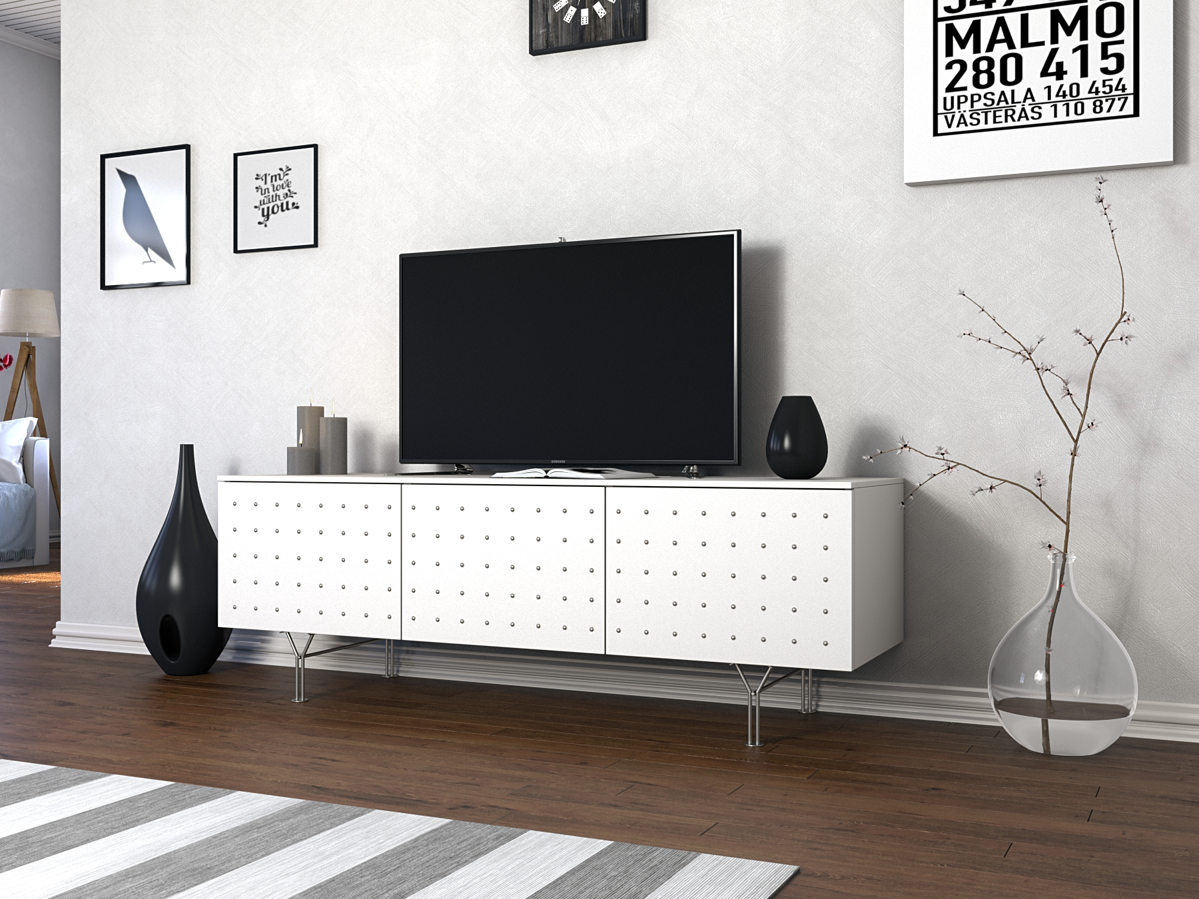
Tv-stand program
Dot's. 1500 mm
Design Johan Hellström

Slide 6
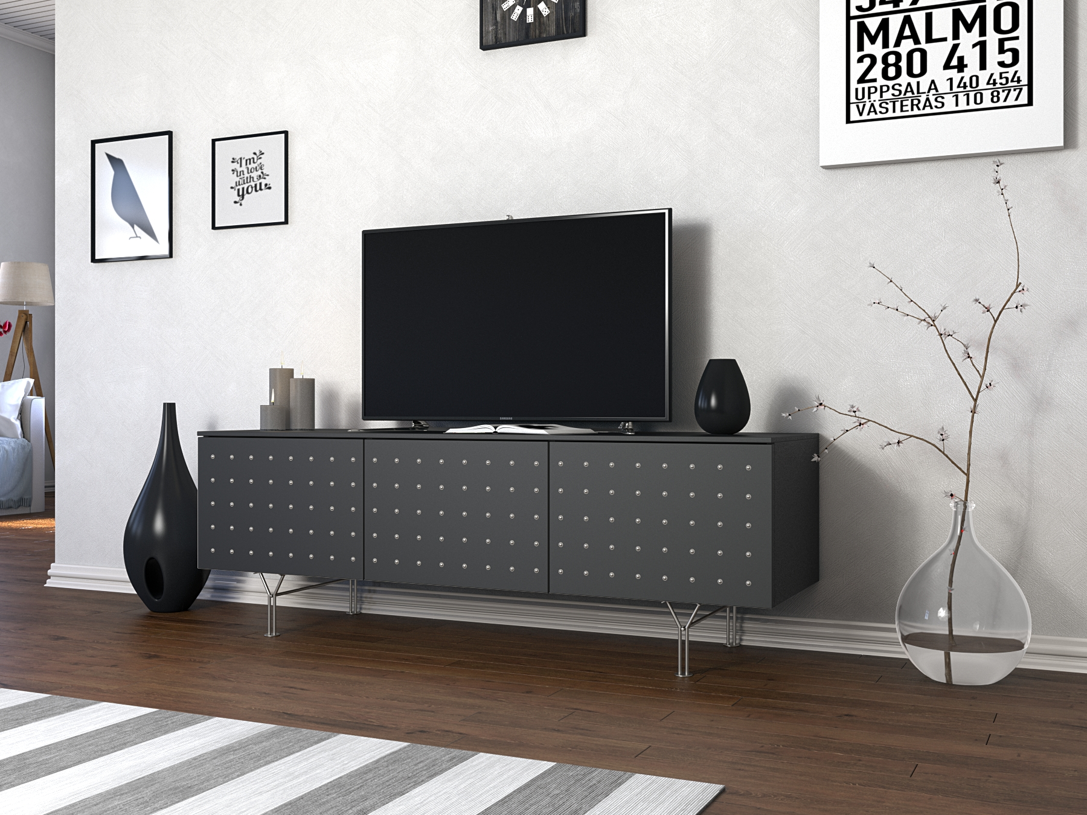
Tv-stand program
Dot´s. black 1500 mm
Design Johan Hellström

Slide 7
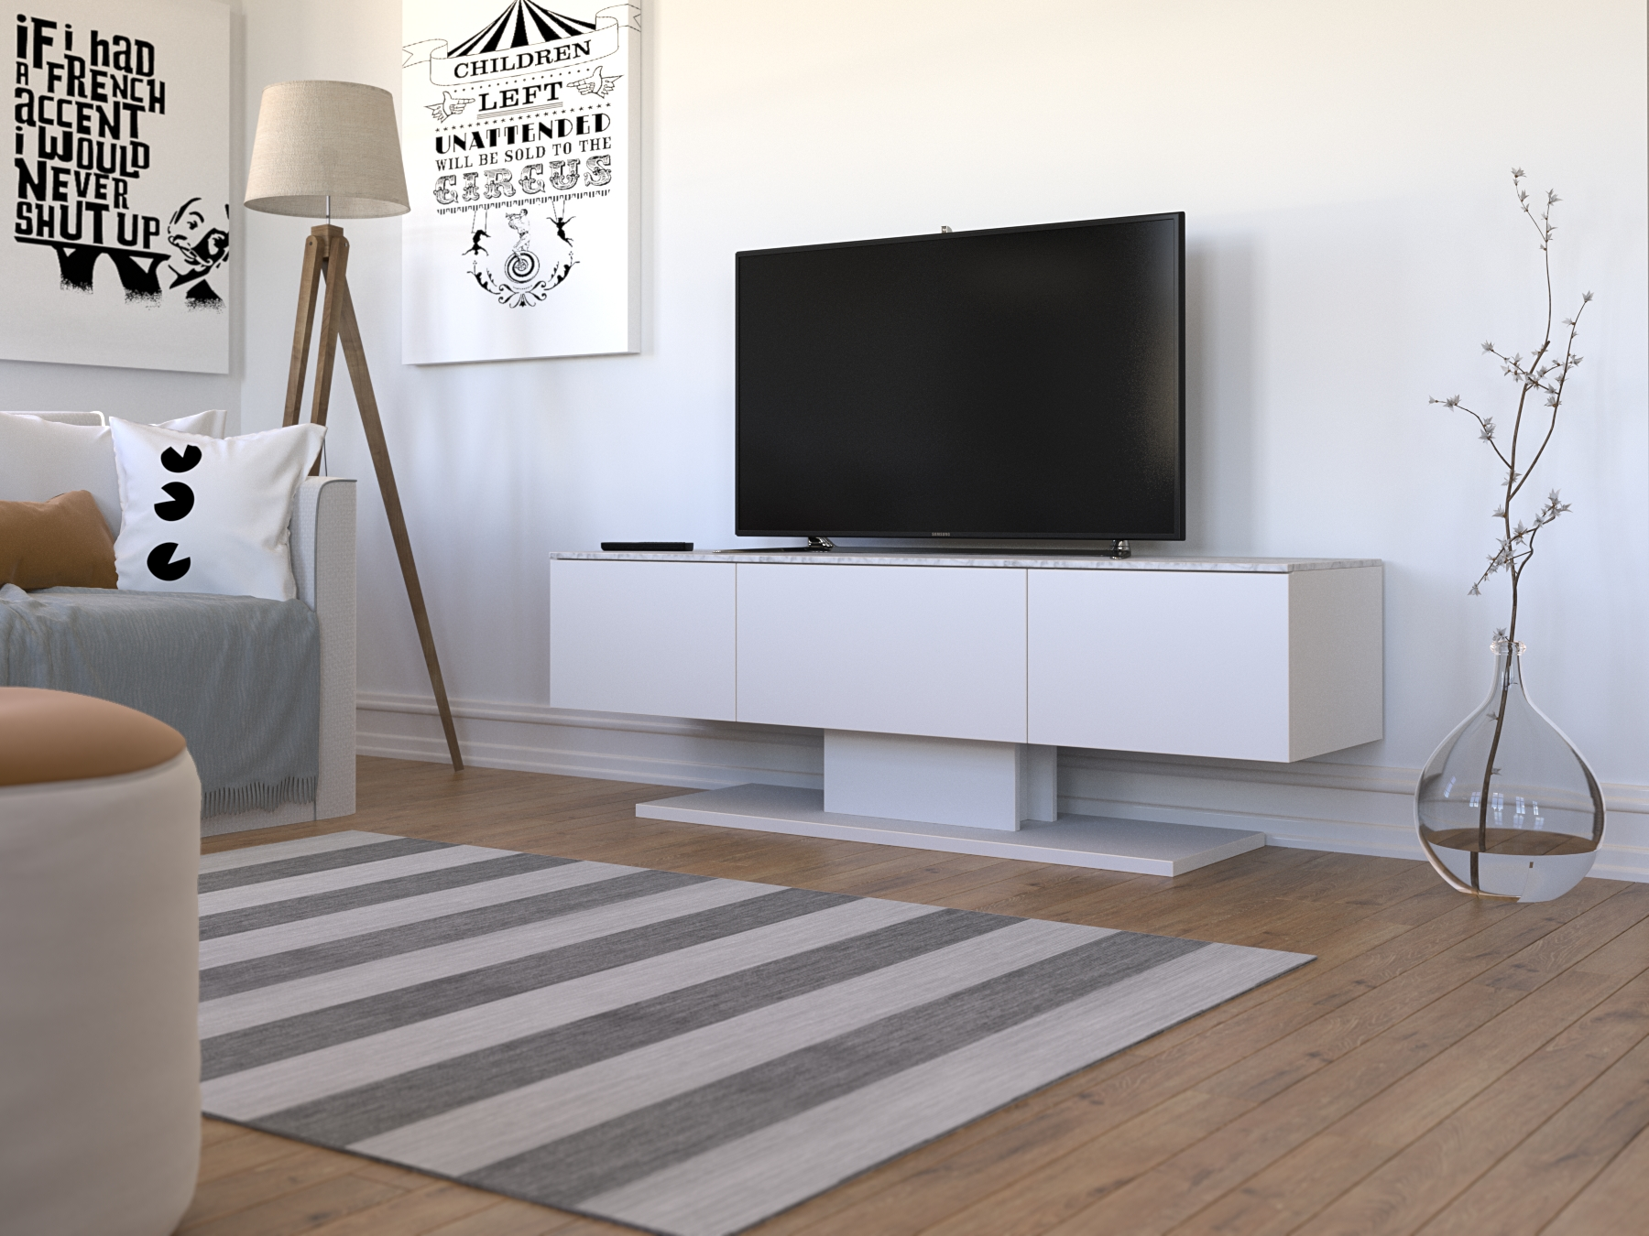
Tv-stand program
Loft. white, marble top 1500 mm
Design Johan Hellström

Slide 8
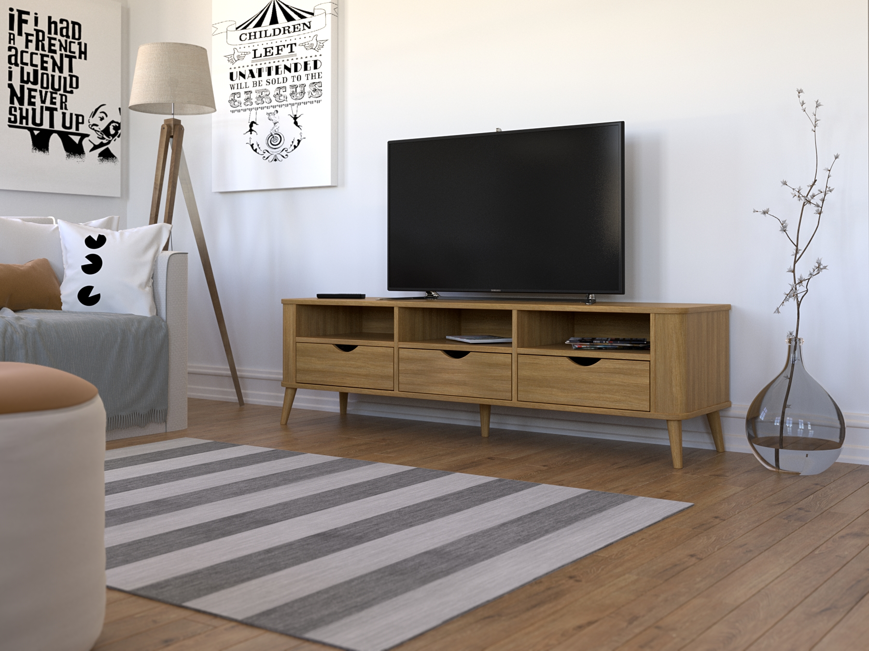
Tv-stand program
Oregon. 1600 mm , oak
Design Johan Hellström

Slide 9
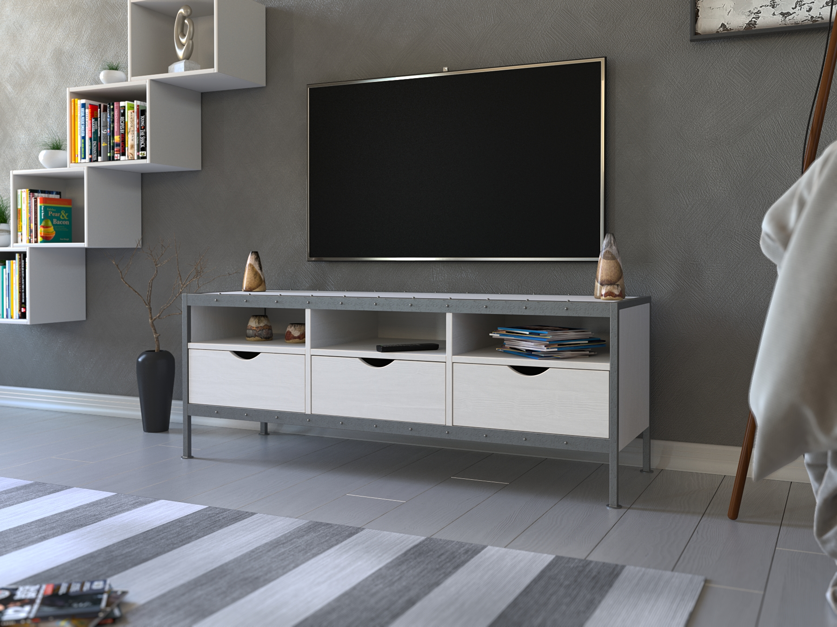
Tv-stand program
Rivet. 1600 mm ,white oak, grey steel
Design Johan Hellström

Slide 10
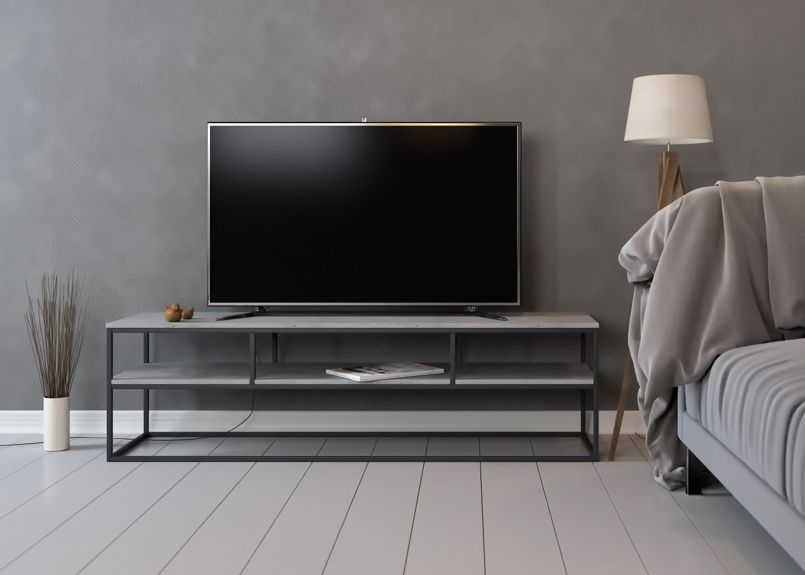
Tv-stand program
Berlin .
1600 mm , firbre cement tops
Design Johan Hellström

Slide 11
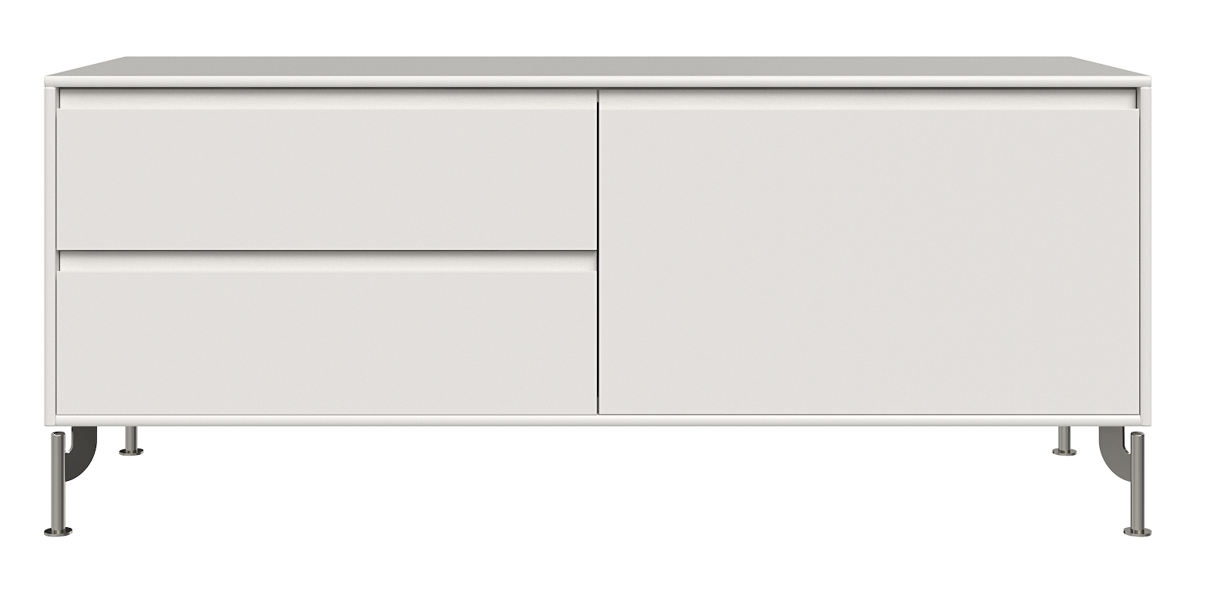
1200 mm
Tv-stand program
Jylland.
1600 mm
2000 mm
Design Johan Hellström

Slide 12
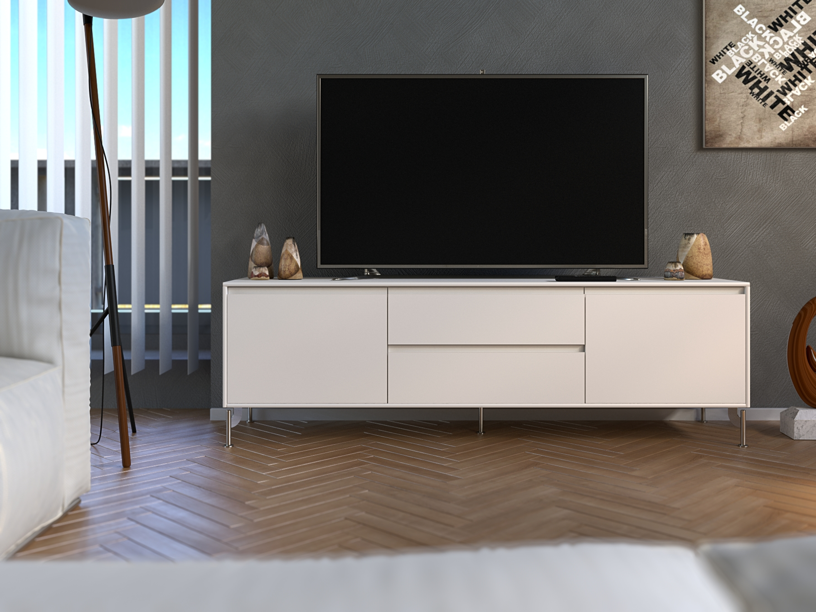
Tv-stand program
Jylland. 1600 mm ,white
Design Johan Hellström

Slide 13
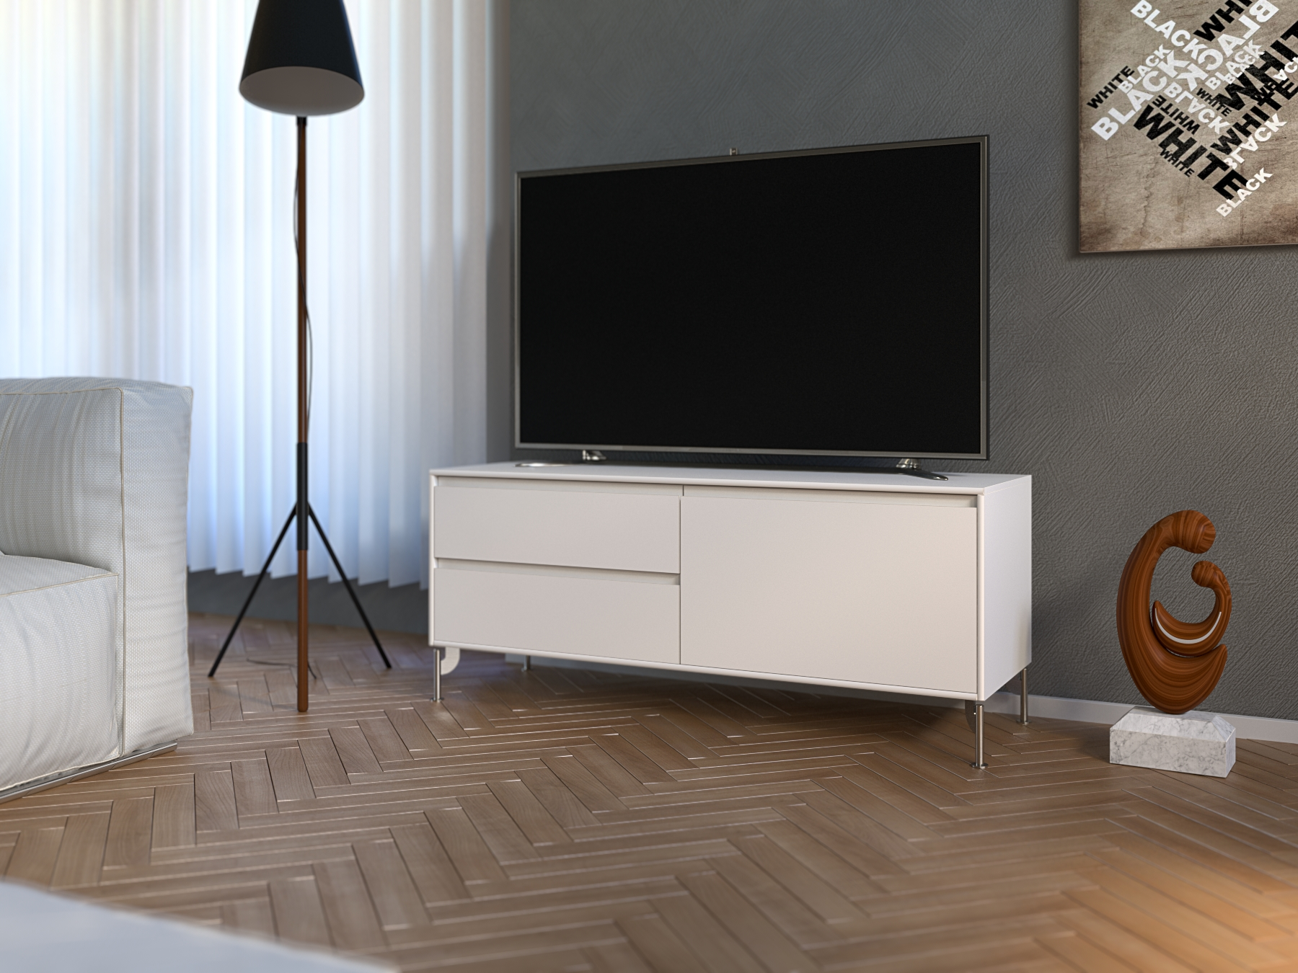
Tv-stand program
Jylland.
1200 mm ,white
Design Johan Hellström

